Slide 1
Movie recommendation system
Sprint 8

Slide 2
Sprint goals recap:
Work on style
Project set up
Performance and gorilla testing
Improved style guide
Fetch API with movie posters

Slide 3
Challenges:
Issues with cors and browser with self sign SSL to use HTTPS
MySQL

Slide 4
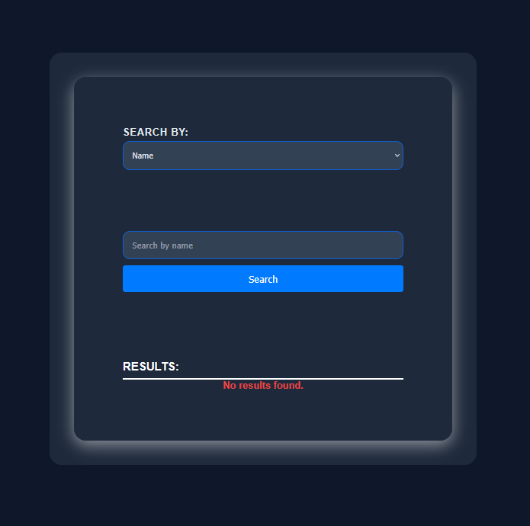

Slide 5
Thank you
Presented by:
Julia, Martin, Matthew

